Slide 1
Knowledge Representation and Reasoning
Kapil Dev Pant

Slide 2
Content
Propositional Logic
Syntax
Semantics
Inference in Propositional Logic
Conjunctive Normal Form (CNF)
Resolution Theorem Proving
Limitations of Propositional Logic
Predicate Logic
Syntax
Semantics
Inference in Predicate Logic
Resolution in Predicate Logic
Reasoning Under Uncertainty
Probabilistic Reasoning
Bayesian Networks
Probabilistic reasoning over time
Hidden Markov Models
Other Approaches to Knowledge Representation
Semantic Nets and Frames
Rule-based Representation
Ontological-Based Representation

Slide 3
Approaches to Knowledge Representation
1. Simple relational Knowledge
Represents knowledge using relations among objects. The data is typically structured in tables or tuples (like in a relational database).
Consists of objects and their properties or relationships in tabular format.
Eg.
Advantages:
Easy to store and query
Suitable for factual knowledge
Limitations:
Lacks inference capability
Can't express hierarchical or procedural relationships
Student | Course | Grade
John | AI | A
Alice | DBMS | B+

Slide 4
Approaches to Knowledge Representation
2. Inheritable knowledge
Represents knowledge in a hierarchical structure where lower levels inherit properties from higher levels (like in object-oriented systems or semantic networks).
Eg.
Animal
└── Bird
└── Sparrow
Advantages:
Reduces redundancy through inheritance
Mimics human categorization
Limitations:
Not all knowledge fits clean hierarchies
Inheritance conflicts may arise (e.g., penguins)

Slide 5
Approaches to Knowledge Representation
3. Inferential Knowledge
Represents knowledge in a way that supports inference or logical deduction. Often expressed using rules and logic. And this method guarantees correctness
E.g. IF person(x) AND studies(x, ComputerScience) THEN isStudent(x)
From: person(John), studies(John, ComputerScience)
We can infer: isStudent(John)
Advantages:
Reduces redundancy through inheritance
Mimics human categorization
Limitations:
Not all knowledge fits clean hierarchies
Inheritance conflicts may arise (e.g., penguins)

Slide 6
Approaches to Knowledge Representation
4. Procedural Knowledge
Describes how to do something. It includes the steps, procedures, or algorithms to achieve a task or goal. In this approach IF-then rule is used.
Advantages:
Directly executable
Suitable for automation
Limitations:
Hard to explain or extract as declarative facts
Often embedded in code

Slide 7
Introduction to propositional Logic
What is Propositional Logic ?
PL is a branch of logic that deals with statements or propositions and their logical relationships and connections
It deals with what is true or false
It does not deal with why or how
Importance in AI and Logical Reasoning
Forms foundation of Logical Reasoning
For knowledge representation and decision making
Basis for automated reasoning and theorem proving
Notes:
Knowledge Representation in AI is the method of structuring and organizing knowledge so that AI systems can process and utilize it for reasoning and decision-making.
This article aims to provide a comprehensive overview of knowledge representation in AI, exploring its methods, types, techniques, challenges, and applications.
What is Propositional Logic?
Propositional logic, also called propositional calculus, is a branch of logic that deals with statements or propositions and their logical relationships and connections.
Propositional logic is necessary because it provides a formal system for representing and reasoning about statements that can be either true or false. It serves as the foundation for more complex logical systems and is widely used in various fields, including computer science, artificial intelligence, mathematics, and philosophy. Here's why it's important:
Formalizing Reasoning: Propositional logic helps in formalizing reasoning processes. It allows us to represent logical relationships between propositions (statements), and make inferences based on their truth values, which is essential for tasks like problem-solving, decision-making, and automated reasoning.
Simplicity and Structure: It simplifies complex reasoning by breaking it down into basic components—propositions that are either true or false. This simplicity makes it easier to analyze and manipulate logical statements systematically.
Basis for Advanced Logic: Propositional logic is the basis for more advanced logical systems, such as predicate logic, temporal logic, and modal logic. It’s a stepping stone for studying more complex systems used in areas like automated theorem proving and logic programming.
Used in Computer Science: Propositional logic is essential in computer science, especially in fields like artificial intelligence, where it is used for knowledge representation, automated reasoning, and decision-making. It’s also foundational in database theory, compiler design, and hardware design (e.g., Boolean algebra in circuit design).
Verification and Validation: It helps in verifying and validating systems, particularly in formal methods, where the correctness of software, algorithms, or hardware can be proven mathematically by using propositional logic.
Mathematical Proofs: Propositional logic provides a rigorous framework for constructing proofs. It ensures that inferences made from given premises are logically sound.
Automating Tasks: In AI, propositional logic is used to automate tasks such as decision-making, planning, and knowledge representation, which are critical for intelligent systems.

Slide 8
Syntax
Components
Propositions: {declarative sentence that has a definite truth value (True or False)}
Represented using Symbols
Example: P: “It is raining”
Q: “The road is wet”
Logical Connectives
NOT (¬) : It is not raining
AND (∧): It is raining and road is wet
OR (∨): it is raining or road is wet
IMPLIES (→) : it it is raining m then road is wet
BICONDITIONAL (↔) : Rains iff road is wet
Valid propositions:
“Kathmandu is the capital of Nepal.” ➔ True
“5 + 3 = 10.” ➔ False
Not propositions:
“Open the door.” (command)
“Is it raining?” (question)
OR is inclusive
i.e. one or both can be true

Slide 9
Propositional Logic
Atomic Propositional
This cant be broken down anymore
It does not contain any logical connectives
Students pass the exam.
CPU temp is above 50%
Students are decent.
Compound Proposition
combining two or more atomic propositions using logical connectives.
Has at least one logical connectives
Student passed the exam and submitted the project.
If a student studies regularly, then the student passes the exam.
A user can access the system if and only if the user is authenticated.
If the server is online and the network is stable, then users can access the system.

Slide 10
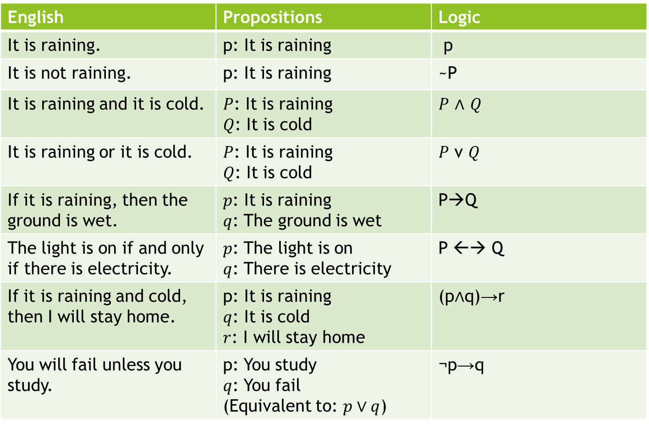
Examples
English | Propositions | Logic
It is raining. | p: It is raining | p
It is not raining. | p: It is raining | ~P
It is raining and it is cold. | $P$: It is raining $Q$: It is cold | $P$ ∧ $Q$
It is raining or it is cold. | $P$: It is raining $Q$: It is cold | $P$ v $Q$
If it is raining, then the ground is wet. | $p$: It is raining $q$: The ground is wet | P→Q
The light is on if and only if there is electricity. | $p$: The light is on $q$: There is electricity | P ←→ Q
If it is raining and cold, then I will stay home. | p: It is raining $q$: It is cold $r$: I will stay home | (p∧q)→r
You will fail unless you study. | p: You study $q$: You fail (Equivalent to: $p∨q$) | ¬p→q

Slide 11

Practice
Watch keywords:
only if = $→$
unless = $¬p→q$
if and only if = $↔$
But works as AND
If I study hard and attend classes, then I will pass the exam, but if I do not study, I will fail.
Only if you work hard will you succeed
If a student passes the exam and submits the project, then the student gets a certificate.
If a student attends lectures regularly and completes assignments, then the student will pass the course.
A student can appear in the final exam only if attendance is above 75%.
A user can access the system if and only if the user is authenticated and authorized.
If a student has not completed the prerequisite course, then the student cannot register for the advanced course.
A student will receive a scholarship if the student has a high GPA and has no disciplinary record.
If the server crashes or the network fails, then the system becomes unavailable.
The software will be deployed only if testing is completed and all critical bugs are fixed.
A system will shut down unless a valid command is entered.
If a candidate is qualified and experienced, then the candidate is selected; otherwise, the candidate is rejected.
Student passed and failed the exam. = ?
Notes:
$p$: I study hard
$q$: I attend classes
$r$: I pass the exam
$s$: I fail
[(p∧q)→r]∧(¬p→s)
2. Only if you work hard will you succeed.
(“Only if” reverses the direction)
$p$: You work hard
$q$: You succeed
Q → P
3. If a student passes the exam and submits the project, then the student gets a certificate.
(p∧q)→r
A user can access the system if and only if the user is authenticated and authorized. p↔(q∧r)
If a student has not completed the prerequisite course, then the student cannot register for the advanced course. ¬p→¬q
A student will receive a scholarship if the student has a high GPA and has no disciplinary record. (p∧q)→r
If the server crashes or the network fails, then the system becomes unavailable. (p∨q)→r
The software will be deployed only if testing is completed and all critical bugs are fixed. P → (q ^ R)
A system will shut down unless a valid command is entered.
$p$: A valid command is entered
$q$: System shuts down
–p → q
If a candidate is qualified and experienced, then the candidate is selected; otherwise, the candidate is rejected.
p: Candidate is qualified
$q$: Candidate is experienced
$r$: Candidate is selected
$s$: Candidate is rejected
[(p∧q)→r]∧¬(p∧q)→s
Student passed and failed the exam.
$p$: Student passed
$q$: Student failed
Even if it sounds contradictory,
p∧q
is still a valid compound proposition (logic cares about structure, not reality).

Slide 12
Semantics
It defines the rules for determining the Truth of a sentence w.r.t particular model.
Assigns truth value either true or false for every propositional symbol
Logical Equivalence: When two statements always have same truth value
Ex: P → Q is equivalent to ¬ P v Q
P←→Q is equivalent (P→Q) ^ (Q→P)
P | Q | - P | -Q | P ^ Q | P V Q | P → Q | P ←→ Q
T | T | F | F | T | T | T | T
T | F | F | T | F | T | F | F
F | T | T | F | F | T | T | F
F | F | T | T | F | f | T | T

Slide 13
Making Truth table
Making truth table if there are more arguments, will be tedious.
E.g.
If there are 3 arguments TTT, then there will be 2^3 = 8 possible combinations.
If there are 10 arguments, then there will be 1024 combinations.
So, first find the validity of simple arguments to limit the no if outputs. We do this by using Rules of Inference.
These rules can be used to construct more complicated arguments.
Output always results in Tautology
TAUTOLOGY | CONTRADICTION | CONTINGENCY
Always TRUE | Always FALSE | Sometimes TRUE or FALSE
Satisfiable | Unsatisfiable | Satisfiable
VALID | INVALID | INVALID
Notes:
Tautology
Compound proposition that is always TRUE , not matter what the truth values of the propositional.
a) p V ¬p
b) (p→q) v (q→p)
Contradiction
Compound proposition that is always FALSE, not matter what the truth values of the propositional variables that occur in it
a) P ^ -P
b) ¬(p^q) ←→ (q^p)
Contingency
Compound proposition that is neither a TAUTOLOGY or a CONTRADICTION
(p → q) ∧ (q → p)
Satisfiability -------Unsatisfiable (contradiction)
Compound proposition is satisfiable is there is at least one true value in its truth table.
P→q) ^ (q→p) satisfiable
P→q)V(q→p) satisfiable and tautulogy
VALID: Compound proposition always VALID when it is a TAUTOLOGY.
INVALID: Compound proposition always INVALID when it is either CONTRADICTION or CONTINGENCY.

Slide 14
Inference in propositional Logic
Deriving Conclusions from Premises or For finding validity of argument
An inference rule is a logical rule that allows us to derive a new true statement (conclusion) from given true statements (premises).
If the premises are true, the conclusion must be true.
Inference rules form the basis of reasoning in:
Artificial Intelligence
Automated theorem proving
Expert systems
Antecedent: The first part of a conditional statement, following “if.”
Consequent: The second part of a conditional statement, following “then
Notes:
Tautology
A formula that is always true
Example: P ∨ ¬P
Contradiction
A formula that is always false
Example: P ∧ ¬P
Contingency
Sometimes true, sometimes false
Example: P ∧ Q
In modus ponens, the first premise expresses an if–then relationship: If the antecedent is true, then the consequent must also be true.
Antecedent: The first part of a conditional statement, following “if.” It is the condition that triggers the outcome.
Consequent: The second part of a conditional statement, following “then.” It is the outcome or result of the antecedent being true
errors known as formal logical fallacies (or non sequitur fallacies).
There are two fallacies in particular that often result from failed attempts at forming a modus ponens argument:
Affirming the consequent: In a conditional syllogism, asserting that the consequent (i.e., the “then” statement) is true does not provide logical certainty.
Example: In the argument “If it’s raining, then the streets are wet. The streets are wet. Therefore, it’s raining,” there are other potential reasons the streets might be wet. This argument is fallacious.
Denying the antecedent: In a conditional syllogism, denying the truth of the antecedent (i.e., the “if” statement) likewise fails to provide logical certainty.
Example: In the argument “If it’s raining, then the streets are wet. It’s not raining. Therefore, the streets are not wet,” there could be factors other than rain causing the streets to be wet, so this argument is also fallacious.
Both fallacies are attempts at conditional syllogisms that misrepresent the relationship between the antecedent and the consequent, leading to flawed reasoning.
Modus ponens is not a logical fallacy; it is a valid form of deductive reasoning. Also known as “affirming the antecedent,” it employs a straightforward logical structure:
If P, then Q.
P.
Therefore, Q.
However, flawed attempts at forming a syllogism often result in formal logical fallacies, such as denying the antecedent, which resembles modus ponens in form but fails to provide logical certainty:
If P, then Q.
Not P.
Therefore, not Q.
Although the two arguments look similar, denying the antecedent is an invalid form of argument.

Slide 15
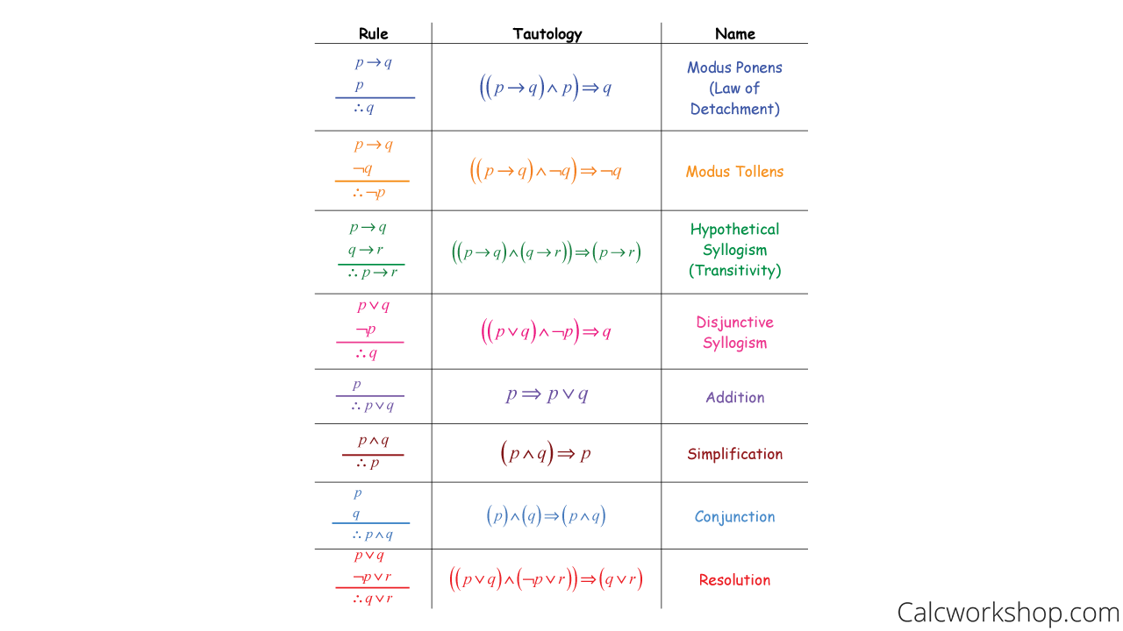
If P implies Q and P is true,
then Q must be true.
If P implies Q and Q is false,
then P must be false.
p
If P implies Q and Q implies R,
then P implies R.
If one of the propositions is false,
the other must be true.
If P is true,
then P OR Q is true
(even if Q is unknown).
Or introduction
From a conjunction, each part
can be inferred separately. Or Q
AND elimination
If P is true and Q is true,
then P AND Q is true.
Eliminate complementary
literals to derive a new clause.
Notes:
If P implies Q and P is true, then Q must be true.
If P implies Q and Q is false, then P must be false.
Hypothetical Syllogism
If P implies Q and Q implies R, then P implies R.
P → Q
Q → R
---------
∴ P → R
Disjunctive Syllogism
If one of the propositions is false, the other must be true.
P ∨ Q
¬P
---------
∴ Q
And Introduction (Conjunction)
If P is true and Q is true, then P AND Q is true.
P
Q
---------
∴ P ∧ Q
And Elimination (Simplification)
From a conjunction, each part can be inferred separately.
P ∧ Q
---------
∴ P or Q
Or Introduction (Addition)
If P is true, then P OR Q is true (even if Q is unknown).
P
---------
∴ P ∨ Q
Resolution Rule (Very Important in AI)
Eliminate complementary literals to derive a new clause.

Slide 16
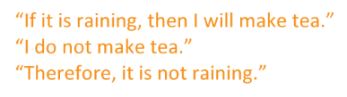
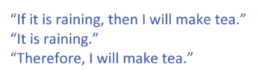
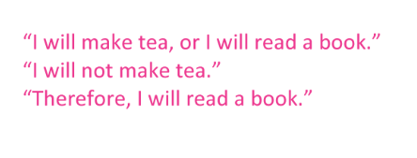
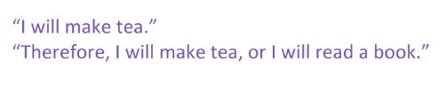
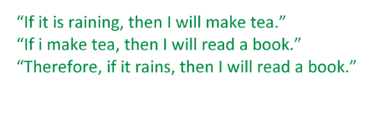
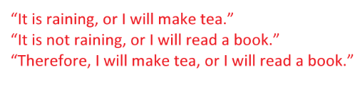
Examples:

Slide 17
Conjunctive Normal form (CNF)
Product of elementary sums
Example: (P ∨ ¬Q) ∧ (¬P ∨ R).
Sums of elementary products (DNF)
Methods of Conversion:
1. Eliminate ↔ and →.
2. Eliminate ¬ before sums and products by De Morgan’s Laws.
3. Distribute ∨ over ∧.
α ⇔ β with (α ⇒ β) ∧ (β ⇒ α).
α ⇒ β with ¬α ∨ β.
¬(α ∨ β) ≡ ¬α ∧ ¬β,
¬(α ∧ β) ≡ ¬α ∨ ¬β,
¬¬α ≡ α.
(α ∧ β) ∨ γ ≡ (α ∨ γ) ∧ (β ∨ γ)

Slide 18
example
Expression Type | Need Distributivity? | Reason
( a ∨ b ) ∧ ¬ c | No | Already CNF (conjunction of clauses)
( a ∧ b ) ∨ c | Yes | Disjunction over conjunction — not CNF
( a ∨ ( b ∧ c ) ) | Yes | Need to distribute OR over AND
P ^ ( P -> Q)
(P -> Q) ^ ~Q
(P -> Q^ R) ^ (~P -> ( ~Q ^ ~R))
(a ^b ) v (c ^d) v e
(a ^ b ^ c ) v –(- d v e)
P ←→ ( Q v R)
(-P → R) ^ ~ (P ←→ Q)
-(P v Q) ←→ (P ^Q)

Slide 19
Resolution Theorem Proving
A rule of inference for CNF Used to prove if an argument is correct or not
Literals : a variable or negation of variable
Clause : disjunction of literals
Resolvent : disjunction result obtained by deleting complements from clauses or logical consequence of 2 clauses
Key Steps:
Convert statements to CNF.
Use resolution to infer contradictions or conclusions.
Notes:
1. Infer a contradiction
A contradiction occurs when resolution produces the empty clause ( ).
This usually happens when:
You assume the negation of the conclusion
And show that this assumption leads to inconsistency
📌 This is called proof by refutation.
2. Infer a conclusion
If adding ¬Goal leads to a contradiction,
Then the Goal must be true.
So:
$$KB⊨Goal$$

Slide 20
Example
A = B v C v D
B = ~B v E v F
Resolvent is: C v D v E v F
Solve modus ponens , modus tollens rule. Hypothetical
Prove that: The match is canceled.
If it is raining, then the ground is wet.
If the ground is wet, then the match is canceled.
It is raining.

Slide 21
example
If a student studies and attends classes, then the student will pass the exam.
If a student passes the exam, then the student gets a job.
The student studies.
The student attends classes.
Goal
Prove that the student gets a job.

Slide 22
Examples for propositional logic
If it is not raining, then the road is not wet
If it is raining, then the road is wet, and if the road is wet, then it is raining
It is not the case that both it is baked, and the road is wet
If the road is wet, then it is raining, but if it is not raining, then the road is not wet.
If the sun is shining, then the grass is dry; if the grass is not dry, then the sun is not shining
It is not true that both the cake is baked, and the oven is off
If the phone is charged, then it will turn on, and if the phone turns on, then it is charged
If the library is open, then the books are available; if the books are not available, then the library is closed

Slide 23
Limitations of Propositional Logic
Can’t establish truth of prop. That is not in the premise or that can’t be inferred by laws of inference.
Expressive Power: Cannot handle quantifiers (e.g., “for all,” “there exists”).
Scalability: Inefficient for large, complex systems.
No Reasoning About Objects: Only deals with true/false propositions.

Slide 24
Predicate logic
In propositional logic we can represents only facts, which are either true or false. Limiting complex or natural languages.
Is an extension of Propositional Logic
Predicate logic aka First order logic aka First order predicate logic.
formal system that uses objects/ variables and quantifiers (∀, ∃) to formulate propositions
Predicate is a part of declarative sentences describing the properties of an object or relation among objects and functions.
Objects: A, B, People, numbers, color…..
Relations: It can be unary relation (red, round, is adjacent) or n-any relation (sister of, brother of, has color, comes between…)
Notes:
Ram is brother of Lakshman , either true or false but
X is brother of y==?
here we use predicate logic for variables.

Slide 25
Predicate logic
Key Components:
Constants : represents objects A, B, C, D, cat, dog, ram, Shyam.
Variables: represents arbitrary elements ( x, y, z, a, b,..)
Predicates : Describes properties or relationships
P(x): “ x is a student“ , here x is subject and “is a student” is predicate
Q(x, y) : “ x is friend of y”, here x, y are subjects and “ is a friend” is predicate

Slide 26
Quantifiers in Predicate logic
Quantifiers specify how many objects satisfy a predicate
Quantifiers : Scope of variable➔ “ALL” or “SUM”
Universal Quantifier: ∀x (P(x)) reads as (For All x, P(x) holds)
∀xP(x): "All x are students."
Existential Quantifiers: ∃x (P(x)) (There exists x such that P(x) holds)
∃xP(x): "There exists an x such that x is a student.“
Example: “Everyone love Someone”
Predicate logic: ∀x ∃y Loves (x, y)
Use of implication and conjunction:
All students are intelligent == ∀x Student(x) → Intelligent(x)
There exists a student who is intelligent == ∃x Student(x) ∧ Intelligent(x)

Slide 27
Syntax
Set of rules that makes the structure of sentence in Predicate logic
Atomic Formula: Basic statements formed using predicates, constants, and variables.
Example: P(a), Q(x, y)
Ram is eating : eating(Ram)
Anil and bhuppi are friends: friends (Anil, Bhuppi)
Complex Formula: Built from atomic formulas using quantifiers and logical connectives.
Example: ∀x(P(x)→Q(x)): "For all x, if x is a student, then x is diligent.

Slide 28
Semantics
Assigns meaning to predicates and terms (Syntax).
Domain: set of objects that refers variable.
Interpretation Function: maps constants to object, predicates to relations and variables to elements.
Truth Condition :
Universal (∀): True if the predicate holds for all elements in the domain.
Existential (∃): True if the predicate holds for at least one element.
Example:
Domain : {x, y}{Alice, Bob}
Predicate: Loves(x, y) Loves(Alice, Bob) is true if Alice loves bob.

Slide 29
Example
Statement: "All humans are mortal, and Socrates is a human. Therefore, Socrates is mortal.“
Representation in Predicate Logic:
Human(x): "x is a human."
Mortal(x): "x is mortal."
Socrates: A constant representing Socrates.
Logical Form:
∀x(Human(x)→Mortal(x)) (All humans are mortal).
Human(Socrates) (Socrates is a human).
Conclusion: Mortal(Socrates) (Socrates is mortal).
Example: Domain: {Ram, Sita} Predicate: Human(x)
If both are humans, then:
∀x Human(x) is TRUE

Slide 30
Examples of Predicate logic
All birds can fly.
There exists a teacher who teaches AI.
All students who study AI are intelligent.
Every teacher teaches at least one subject.
If the sun is shining, then the grass is dry for all locations
If the grass is not dry at some location, then the sun is not shining at that location
There is some location where the sun is shining, and the grass is not dry
If a car is parked, then its engine is off for all cars
If a phone is charged, then it will turn on, and if it turns on, then the phone is charged
Every phone that is charged will turn on, and there is a phone that is not charged but will not turn on
Notes:
All birds can fly
∀x Bird(x) → CanFly(x)
There exists a teacher who teaches AI.
∃x Teacher(x) ∧ Teaches(x, AI)
All students who study AI are intelligent.
∀x (Student(x) ∧ Studies(x, AI)) → Intelligent(x)
Every teacher teaches at least one subject.
∀x Teacher(x) → ∃y Teaches(x, y)
No student is lazy.
∀x Student(x) → ¬Lazy(x)
Some doctors work in hospitals.
∃x Doctor(x) ∧ WorksIn(x, Hospital)

Slide 31
Examples of Predicate logic
If the sun is shining, then the grass is dry for all locations
Explanation:
∀x: This universal quantifier means "for all x."
Shining(Sun(x)): This predicate represents "the sun is shining at location x."
Dry(Grass(x)): This predicate represents "the grass is dry at location x."
→: This symbol represents the logical implication "if...then."
∀x (Shining(Sun(x)) → Dry(Grass(x)))

Slide 32
Examples of Predicate logic
If the grass is not dry at some location, then the sun is not shining at that location
∃x (¬Dry(Grass(x)) → ¬Shining(Sun(x)))
There is some location where the sun is shining, and the grass is not dry
∃x (Shining(Sun(x)) ∧ ¬Dry(Grass(x)))
If a car is parked, then its engine is off for all cars
∀x (Parked(Car(x)) → Off(Engine(x)))
If a phone is charged, then it will turn on, and if it turns on, then the phone is charged
∀x (Charged(Phone(x)) → TurnsOn(Phone(x))) ∧ (TurnsOn(Phone(x)) → Charged(Phone(x))))
Every phone that is charged will turn on, and there is a phone that is not charged but will not turn on
∀x (Charged(Phone(x)) → TurnsOn(Phone(x))) ∧ (TurnsOn(Phone(x)) → Charged(Phone(x))))

Slide 33
Examples of Predicate logic
If a phone is charged, then it will turn on, and if it turns on, then the phone is charged.
∀x: This universal quantifier means "for all x.
"Charged(Phone(x)): This predicate represents "phone x is charged.
"TurnsOn(Phone(x)): This predicate represents "phone x turns on.
"→: This symbol represents the logical implication "if...then.
"∧: This symbol represents the logical conjunction "and.“
∀x (Charged(Phone(x)) → TurnsOn(Phone(x))) ∧ (TurnsOn(Phone(x)) → Charged(Phone(x))))

Slide 34
Inference in Predicate Logic
Deriving new conclusions from set of given premises using logical rules. It extends the principle of propositional logic by incorporating quantifiers , variables and predicates.
Techniques:
- Substitution: Replace variables with constants or other variables.
Modus Ponens: If P → Q and P are true, infer Q.
- Generalization and Specialization:
From P(c) infer ∀x P(x).
From ∀x P(x) infer P(c).
- Unification: Matching predicates with variables and constants.
Example:
Premises: ∀x (Human(x) → Mortal(x)), Human(Socrates)
Inference: Mortal(Socrates)
- Modus tollens:
If P(x) → Q(x) and ¬Q(a), conclude ¬P(a)
Premises: Animal(x) → NeedsFood(x), ¬NeedsFood(Robot)"
Conclusion: ¬Animal(Robot)"
Notes:
Key Inference Rules in Predicate Logic
Universal Specification (US): From a universally quantified statement, you can conclude a specific instance.
Form: If ∀x P(x) is true, then P(c) is true for any specific c.
Example: If all humans are mortal (∀x (Human(x) → Mortal(x))), then Socrates is mortal (Mortal(Socrates)) if Socrates is a human.
Universal Generalization (UG): If a statement is true for a specific instance, it can be generalized to all instances.
Form: If P(c) is true for an arbitrary c, then ∀x P(x) is true.
Example: If Socrates is mortal, and he is a human, we can conclude that all humans are mortal.
Existential Specification (ES): From an existentially quantified statement, you can conclude a specific instance.
Form: If ∃x P(x) is true, then P(c) is true for some specific c.
Example: If there exists a human who is mortal (∃x (Human(x) ∧ Mortal(x))), we can name that human (e.g., Socrates) and conclude that Human(Socrates) ∧ Mortal(Socrates) is true.
Existential Generalization (EG): If a specific instance is true, it can be generalized to an existential statement.
Form: If P(c) is true, then ∃y P(y) is true.
Example: If Socrates is mortal (Mortal(Socrates)), we can conclude that there exists a mortal (∃x Mortal(x))

Slide 35
Inference Rules in Predicate Logic
Universal Specification (US): From a universally quantified statement, you can conclude a specific instance.
Form: If ∀x P(x) is true, then P(c) is true for any specific c.
Example: If all humans are mortal (∀x (Human(x) → Mortal(x))), then Socrates is mortal (Mortal(Socrates)) if Socrates is a human.
Universal Generalization (UG): If a statement is true for a specific instance, it can be generalized to all instances.
Form: If P(c) is true for an arbitrary c, then ∀x P(x) is true.
Example: If Socrates is mortal, and he is a human, we can conclude that all humans are mortal.
Existential Specification (ES): From an existentially quantified statement, you can conclude a specific instance.
Form: If ∃x P(x) is true, then P(c) is true for some specific c.
Example: If there exists a human who is mortal (∃x (Human(x) ∧ Mortal(x))), we can name that human (e.g., Socrates) and conclude that Human(Socrates) ∧ Mortal(Socrates) is true.
Existential Generalization (EG): If a specific instance is true, it can be generalized to an existential statement.
Form: If P(c) is true, then ∃y P(y) is true
Example: If Socrates is mortal (Mortal(Socrates)), we can conclude that there exists a mortal (∃x Mortal(x))

Slide 36
Conversion to CNF: Part 1
Eliminate biconditionals and implications:
Eliminate ⇔, replacing α ⇔ β with (α ⇒ β)∧(β ⇒ α).
Eliminate ⇒, replacing α ⇒ β with ¬α∨β.
Move ¬ inwards:
¬(∀x p) ≡ ∃x ¬p,
¬(∃x p) ≡ ∀x ¬p,
¬(α∨β) ≡ ¬α∧¬β,
¬(α∧β) ≡ ¬α∨¬β,
¬¬α ≡ α.
Standardize variables apart by renaming them: each quantifier should use a different variable.

Slide 37
Conversion to CNF: Part 2
4. Skolemize : each existential variable is replaced by a Skolem constant or Skolem function of the enclosing universally quantified variables.
For instance, ∃xRich(x) becomes Rich(G1) where G1 is a new Skolem constant.
“Everyone has a heart” ∀x Person(x) ⇒ ∃y Heart(y)∧Has(x,y) becomes ∀x Person(x) ⇒ Heart(H(x))∧Has(x,H(x)), where H is a new symbol (Skolem function).
5. Drop universal quantifiers
For instance, ∀x Person(x) becomes Person(x).
6. Distribute ∧ over ∨:
(α∧β)∨γ ≡(α∨γ)∧(β∨γ).

Slide 38
Resolution in Predicate Logic
A rule-based approach to infer contradictions, commonly used in automated theorem proving. || powerful rule of inference used in reasoning and proofing system that combines two clauses to eliminate a variable or predicate ad derive anew clause.
Steps:
1. Convert to Clause Form:
-Eliminate implications and rewrite in Conjunctive Normal Form (CNF).
2. Skolemization: Remove existential quantifiers using Skolem constants/functions.
3. Standardize Variables: Rename variables to avoid conflicts.
4. Unification: Identify matching terms to resolve contradictions.
5. Apply Resolution Rule: Combine clauses to derive a contradiction or solution.
Example:
Premises: ¬P(x) ∨ Q(x)
~ P(x) v Q(x)
Resolution: Q(x) v R(x)

Slide 39
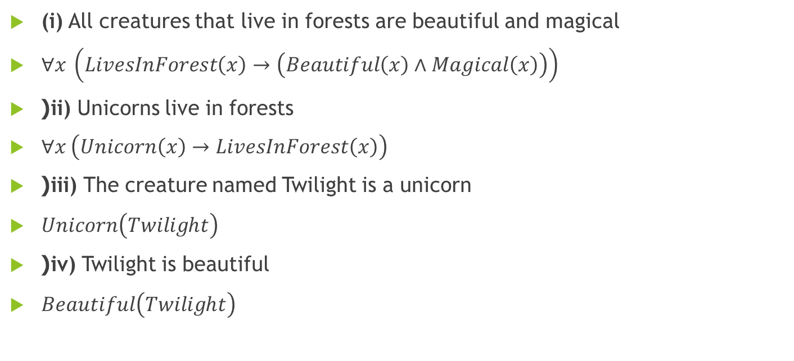
(i) All creatures that live in forests are beautiful and magical
$∀x \left(LivesInForest\left(x\right)→\left(Beautiful\left(x\right)∧Magical\left(x\right)\right)\right)$
(ii) Unicorns live in forests
$∀x \left(Unicorn\left(x\right)→LivesInForest\left(x\right)\right)$
(iii) The creature named Twilight is a unicorn
$Unicorn\left(Twilight\right)$
(iv) Twilight is beautiful
$Beautiful\left(Twilight\right)$

Slide 40
Reasoning Under Uncertainty
Previously We were talking about certain events
in predicate and propositional logic,
i.e. we were sure about predicates,
whether they are true or false
Uncertainties arises where there are incomplete or imperfect knowledge about the situation, outcomes or consequences of action
Different types of uncertainty
For example:
More realistic than previous ones.
You’re deciding whether to carry an umbrella. You’ve seen clouds but aren’t sure if it will rain.
You’re predicting tomorrow’s temperature using two weather models. One predicts 20°C, the other predicts 25°C
You roll a six-sided dice. You don’t know what number will show up because of inherent randomness
Notes:
1. Epistemic Uncertainty
Example: You’re deciding whether to carry an umbrella. You’ve seen clouds but aren’t sure if it will rain.
Probabilistic Reasoning: Based on historical data, you assign a 60% probability that it will rain. As you check a weather app, which shows radar data, you update this probability to 80%.
2. Aleatory Uncertainty
Example: You roll a six-sided dice. You don’t know what number will show up because of inherent randomness.
Probabilistic Reasoning: You model the dice roll with equal probabilities for each outcome:
P(1) = 1/6, P(2) = 1/6, ..., P(6) = 1/6.
3. Model Uncertainty
Example: You’re predicting tomorrow’s temperature using two weather models. One predicts 20°C, the other predicts 25°C.
Probabilistic Reasoning: You assign probabilities to each model’s reliability:
Model A is 70% reliable → Expected temperature = 0.7 × 20°C + 0.3 × 25°C = 21.5°C.
4. Ambiguity
Example: You’re asked, “Do you like spicy food?” but the term "spicy" could mean mild or very hot depending on context.
Probabilistic Reasoning: Instead of a single probability, you give a range:
P(“Yes, I like spicy food”) = 40%-70%, reflecting your uncertainty about the interpretation of "spicy."
5. Partial Observability
Example: You’re trying to locate your dog in the house. You can’t see the dog, but you hear faint barking.
Probabilistic Reasoning: Using Bayesian inference, you update your belief about where the dog might be:
Before hearing barking: Equal chance of being in the living room, kitchen, or bedroom.
After hearing barking near the kitchen: P(kitchen) = 80%, P(living room) = 10%, P(bedroom) = 10%.
6. Dynamic Uncertainty
Example: You’re following traffic updates to decide your driving route. Traffic conditions change unpredictably over time.
Probabilistic Reasoning: A navigation app uses a dynamic model to assign probabilities to routes being faster:
Route A: 50%, Route B: 30%, Route C: 20%.
As new updates come in, the app updates these probabilities dynamically.
7. Uncertainty due to Prior Knowledge
Example: You’ve heard that a restaurant is good but haven’t been there yourself. Based on reviews, you estimate an 80% chance you’ll like it.
Probabilistic Reasoning: After trying the food, you revise your belief:
If you enjoyed it, P(“I’ll like this restaurant”) = 90%.
If you didn’t enjoy it, P(“I’ll like this restaurant”) = 40%.
8. Computational Uncertainty
Example: You’re estimating the chances of winning a card game but can’t calculate all possibilities because there are too many combinations.
Probabilistic Reasoning: You use Monte Carlo simulations, running random trials to approximate a 45% chance of winning.

Slide 41

Probabilistic Reasoning
PR is the method of reasoning and decision making that deals with uncertainty by using various probability theory.
Unlike working with truths and certainties, PR deals with probability and that probability is used to draw conclusion
KEY Concepts:
Uncertainty
Probability
Bayesian Inference
Random Variables
Joint and conditional probabilities
0 <= P(A) <= 1, where P(A) is probability of event A
P(A) = 0, indicated total uncertainty in an event A
P(A) = 1, indicated total certainty in an event A
P(-A) , probability of not happening event A
P(-A) + P(A) = 1
Notes:
Key Concepts in Probabilistic Reasoning
Uncertainty: Probabilistic reasoning acknowledges that in many real-world scenarios, complete knowledge about a situation is unavailable, and outcomes are uncertain. It provides a way to handle this uncertainty systematically.
Probability: Probabilities represent the degree of belief or likelihood of an event occurring. They are expressed as numbers between 0 (impossible) and 1 (certain).
Bayesian Inference: A key approach in probabilistic reasoning is updating probabilities as new evidence becomes available, often using Bayes' Theorem.
Random Variables: Variables whose values are determined by chance. Probabilistic reasoning often models the relationships between these variables.
Joint and Conditional Probabilities:
Joint Probability: Probability of multiple events occurring together. Example: P(A ∩ B) is the probability of both A and B happening.
Conditional Probability: Probability of an event occurring given that another event has occurred. Example: P(A | B) is the probability of A given B.
P(¬A) = probability of a not happening event.
P(¬A) + P(A) = 1

Slide 42
Needs & Application
Needs of PR in AI
When there are unpredictable outcomes
When specifications or possibilities of predicates becomes too large to handle
When an unknown error occurs during an experiment.
Applications:
Medical Diagnosis
Weather Prediction
Natural Language Processing

Slide 43
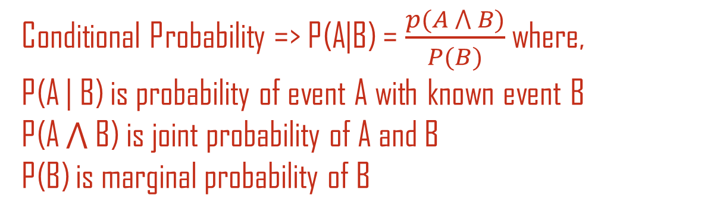
Bayes Theorem
Conditional Probability => P(A|B) = $\frac{p(A ⋀ B)}{P(B)}$ where,
P(A | B) is probability of event A with known event B
P(A ⋀ B) is joint probability of A and B
P(B) is marginal probability of B
Bayes' theorem is also known as Bayes' rule, Bayes' law, or Bayesian reasoning, which determines the probability of an event with uncertain knowledge.
Bayes' theorem can be derived using product rule and conditional probability of event A with known event B:
As from product rule we can write:
P(A ⋀ B)= P(A|B) P(B)
Similarly, the probability of event B with known event A:
P(A ⋀ B)= P(B|A) P(A)
Equating right hand side of both the equations, we will get:
P(A|B) = P(B|A) P(A)
P(B)

Slide 44
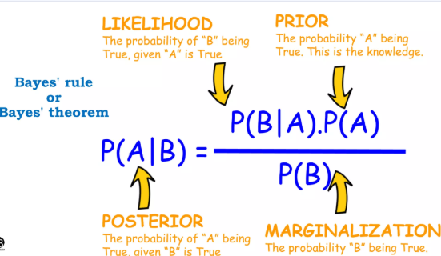
Bayes Theorem

Slide 45
Belief Network | Bayesian Networks
A graphical model representing probabilistic relationships among variables
It is used to model uncertainties and infer probabilities.
Key Components:
DAG, each node representing random variable
Edges , each representing dependencies, relation ship between variables
Conditional Probability distribution P(X | parent(X))
Advantages:
Efficient inference and learning.
Models' complex relationships.
Notes:
It is probabilistic graphical model that represents a set of variables and their conditional dependencies using Directed Acyclic Graphs (DAG).
Nodes: Represent variables.
Edges: Represent dependencies.

Slide 46
Examples of Bayesian Network

Slide 47
Probabilistic reasoning over time
Probabilistic reasoning deals with uncertainty in systems.
Reasoning over time involves understanding temporal dependencies.
Commonly applied in domains like speech recognition, tracking, and finance.
Notes:
Definition: Probabilistic reasoning over time refers to the process of using probability to model, predict, and infer the behavior of dynamic systems where the state evolves over time and uncertainty exists.
It is widely used in systems where the current state depends on past states, and uncertainty arises due to incomplete information, noise, or inherent randomness.
Key Concepts in Probabilistic Reasoning Over Time
1. State and Transition
State: Represents the condition or configuration of the system at a specific time.
Transition: Describes how the system moves from one state to another over time.
2. Temporal Dependencies
The current state depends probabilistically on the previous state(s).
Example:
Weather today depends on yesterday’s weather (e.g., if it rained yesterday, there’s a higher chance of rain today).
3. Markov Assumption
In many models, the Markov property is assumed:
The future state depends only on the current state and not on the full history of past states.
Simplifies calculations and model design.
Common Models for Probabilistic Reasoning Over Time
a. Hidden Markov Models (HMMs)
Components:
States: Hidden or latent variables representing the system’s true condition.
Observations: What we can measure or observe, which are probabilistically related to the hidden states.
Transition Probabilities: Likelihood of moving from one state to another.
Emission Probabilities: Likelihood of an observation given a state.
Example:
Speech recognition:
Hidden states represent phonemes (sounds).
Observations are audio signals.
HMMs infer the most likely sequence of phonemes given the observed signals.
b. Dynamic Bayesian Networks (DBNs)
Extends Bayesian Networks to handle time-dependent processes.
Models probabilistic relationships among variables across multiple time steps.
Allows for more complex dependencies than HMMs.
Example:
Robot navigation:
States include the robot's position and orientation.
Observations include sensor data like distance to obstacles.
DBNs estimate the robot's current position and path over time.
c. Kalman Filters (for continuous systems)
Specialized for linear systems with Gaussian noise.
Provides estimates of the system's state by combining predictions from a model and noisy observations.
Example:
Tracking the position of a moving object, like a drone, using noisy GPS data.
Applications of Probabilistic Reasoning Over Time
Speech and Language Processing
Speech recognition, machine translation, and handwriting recognition.
Robotics and Navigation
Localization and path planning for autonomous vehicles and robots.
Weather Forecasting
Predicting future weather conditions based on current and past observations.
Finance
Modeling stock prices or economic indicators over time.
Healthcare
Monitoring patient health metrics to predict the onset of diseases.
Benefits of Probabilistic Reasoning Over Time
Handles uncertainty in dynamic systems.
Incorporates temporal dependencies for accurate predictions.
Provides a flexible framework applicable to various domains.

Slide 48
Key Concepts
State: A representation of the system at a given time.
Observations: Evidence obtained from the system.
Transition Probabilities: Likelihood of moving from one state to another.
Emission Probabilities: Likelihood of observations given a state.

Slide 49
Markov chain
Stochastic model used to model randomly changing systems
System state is fully observable
Future state depends on present state not on past events
Examples:
Snake ladder game
Weather system

Slide 50
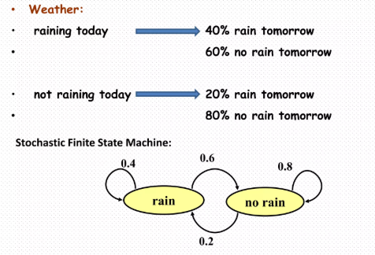
Example

Slide 51
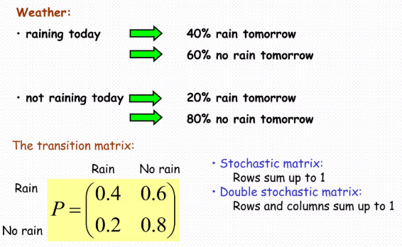
Example

Slide 52
Hidden Markov Models (HMMs)
HMMs are statistical models used to describe sequences of observations.
Key components:
• States: Hidden variables
• Observations: Visible variables
• Transition and Emission Probabilities
Algorithms:
• Forward Backward: Compute probabilities
• Viterbi: Most likely sequence of states
Notes:
1. Key Concepts in Hidden Markov Models (HMMs)
An HMM is a statistical model where:
The system being modeled has hidden states that evolve over time.
Observations provide indirect evidence about these hidden states.
Components of an HMM:
States (S)
Represent the true (hidden) condition of the system.
Example: In speech recognition, states could represent phonemes (small units of sound).
Observations (O)
The measurable outputs generated by the system.
Example: In speech recognition, observations are the audio signals captured from a microphone.
Transition Probabilities (A)
The probability of transitioning from one state to another.
Represented as P(St∣St−1)P(S_t | S_{t-1})P(St​∣St−1​).
Emission Probabilities (B)
The probability of an observation given a state.
Represented as P(Ot∣St)P(O_t | S_t)P(Ot​∣St​).
Initial State Distribution (π)
The probabilities of starting in each state at t=0.
2. Assumptions in HMMs
Markov Assumption:
The current state depends only on the previous state.
P(St∣S1,S2,...,St−1)=P(St∣St−1)P(S_t | S_{1}, S_{2}, ..., S_{t-1}) = P(S_t | S_{t-1})P(St​∣S1​,S2​,...,St−1​)=P(St​∣St−1​).
Output Independence:
Observations depend only on the current state.
P(Ot∣S1,S2,...,St)=P(Ot∣St)P(O_t | S_{1}, S_{2}, ..., S_t) = P(O_t | S_t)P(Ot​∣S1​,S2​,...,St​)=P(Ot​∣St​).
3. How HMMs Work
Step 1: Initialization
Start with an initial state distribution (π).
Step 2: Transition and Observation
At each time step, the system transitions between states based on the transition probabilities (AAA) and generates observations based on the emission probabilities (BBB).
Step 3: Inference and Prediction
The goal is to infer the most likely sequence of states given a sequence of observations.
4. Inference in HMMs
Three fundamental problems are solved in HMMs:
Likelihood Problem (Evaluation):
Compute the probability of a sequence of observations given the model parameters.
Uses the Forward Algorithm.
Decoding Problem (State Sequence):
Determine the most likely sequence of states that could have generated the observed data.
Uses the Viterbi Algorithm.
Learning Problem (Parameter Estimation):
Adjust the model parameters (AAA, BBB, π\piπ) to maximize the likelihood of the observed data.
Uses the Baum-Welch Algorithm (a type of Expectation-Maximization).
5. Example of an HMM
Scenario: Weather Prediction
Hidden States: Sunny, Rainy.
Observations: Wet (W) or Dry (D) ground.
Transition Probabilities: P(Sunny→Sunny)=0.7,P(Sunny \rightarrow Sunny) = 0.7,P(Sunny→Sunny)=0.7, P(Sunny→Rainy)=0.3,P(Sunny \rightarrow Rainy) = 0.3,P(Sunny→Rainy)=0.3, P(Rainy→Rainy)=0.6,P(Rainy \rightarrow Rainy) = 0.6,P(Rainy→Rainy)=0.6, P(Rainy→Sunny)=0.4.P(Rainy \rightarrow Sunny) = 0.4.P(Rainy→Sunny)=0.4.
Emission Probabilities: P(Wet∣Sunny)=0.1, P(Dry∣Sunny)=0.9, P(Wet∣Rainy)=0.8, P(Dry∣Rainy)=0.2.
Initial Probabilities (π): P(Sunny)=0.6,, P(Rainy)=0.4.
Task: Predict Hidden States (Weather) Given Observations Observations: [Wet, Dry, Wet].
Initialization: Start with initial probabilities. Example:
P(Sunny∣Wet)∝P(Wet∣Sunny)⋅P(Sunny)
Recursion (Forward Algorithm): Use transition and emission probabilities to calculate the likelihood of observing the sequence.
Decoding (Viterbi Algorithm): Identify the most probable state sequence:
Observation: Wet → Dry → Wet.
Likely State Sequence: Rainy → Sunny → Rainy.
6. Applications of HMMs
Speech Recognition
Identify spoken words based on audio signals.
Natural Language Processing (NLP)
Part-of-speech tagging, where words are states, and observed words are emissions.
Bioinformatics
Gene prediction based on DNA sequences.
Finance
Predict market trends based on historical data.
Robotics
Track the location of a robot given noisy sensor data.
7. Advantages and Limitations
Advantages:
Efficient for time-series data with uncertainty.
Well-suited for sequential prediction tasks.
Limitations:
Assumes Markov property, which might oversimplify some systems.
Struggles with long-term dependencies due to the "memory-less" nature of states.

Slide 53
Semantic Networks
A graphical representation of knowledge using nodes and links.
Components:
Nodes: Represent objects or concepts.
Links: Represent relationships.
Example:
'Dog' → (is-a) → 'Animal'
'Dog' → (action) → 'Barks'
Advantages:
Intuitive and easy to visualize.

Slide 54
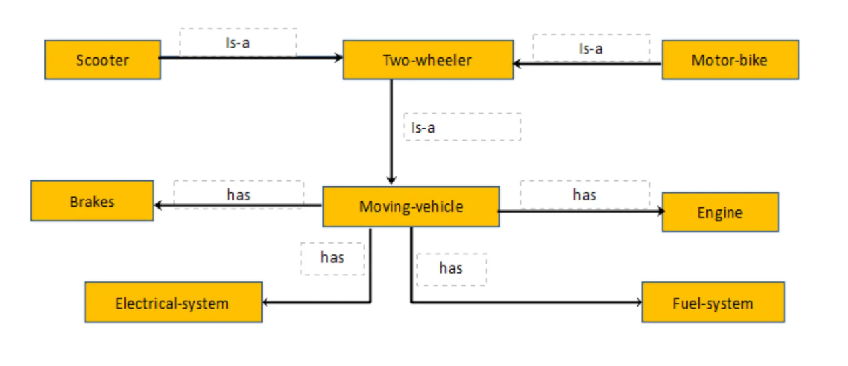
Example
Information that can be possible:
1. A Scooter is a two-wheeler and is a moving vehicle
2. A moving vehicle needs an engine (could be petrol or diesel), a fuel engine to sustain the engine running, an electrical system for lights, horns, initial ignition and brakes.

Slide 55
Frames
Structured knowledge representation using attributes (slots) and values.
Components:
Slots (Packets): Attributes of the concept.
Values: Information for each attribute.
Example:
Frame: 'Hotel'
Slots: Rooms, Price, Location
Values: 100 rooms, $200/night, Downtown
Advantages:
Good for capturing stereotypical knowledge.

Slide 56
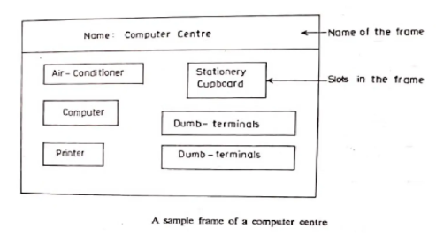
Example

Slide 57
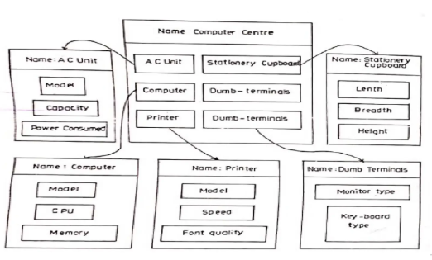
Linking of sub frames

Slide 58
Rule based Representation
Knowledge is represented as a set of if-then rules. This belongs to PL and FOPL.
Structure:
IF condition THEN action/conclusion.
Example:
Rule: If it is raining, then carry an umbrella.
Advantages:
Easy to implement and widely used in expert systems.

Slide 59
Ontological Representation
A formal Representation of a domain’s concepts, categories and relationships.
It provides a structured framework to understand and share knowledge.
Purpose:
To define a common vocabulary for information sharing.
To enable reasoning about entities within a domain.
Components
Objects: Abstract representations of objects or ideas (e.g., 'Person,' 'Vehicle').
Relationships :Define how concepts are interconnected (e.g., 'is-a,' 'part-of').
Properties: Attributes or characteristics of concepts (e.g., 'age,' 'color’).
Categories: Group of Objects.
Axioms: Logical assertions about concepts and relationships (e.g., 'Every person has a name').
Notes:
Concepts: Abstract representations of objects or ideas (e.g., 'Person,' 'Vehicle').
Relationships: Define how concepts are interconnected (e.g., 'is-a,' 'part-of').
Properties: Attributes or characteristics of concepts (e.g., 'age,' 'color').
Instances: Specific examples of concepts (e.g., 'John,' 'Tesla Model 3').
Axioms: Logical assertions about concepts and relationships (e.g., 'Every person has a name').

Slide 60
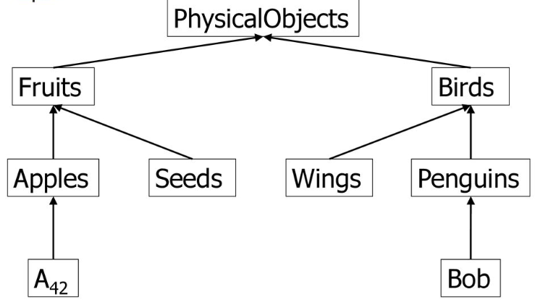
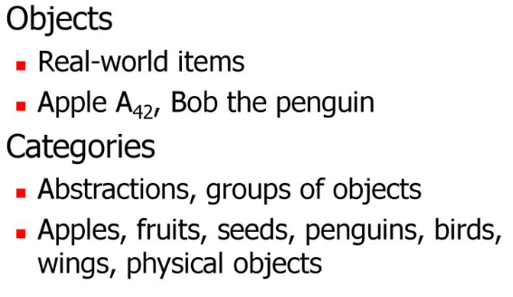
Objects and Categories

Slide 61
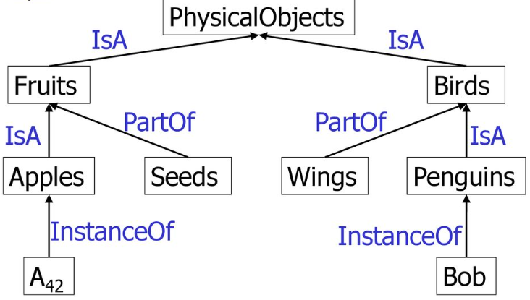
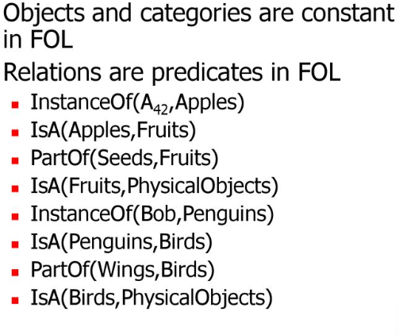
Relations

Slide 62
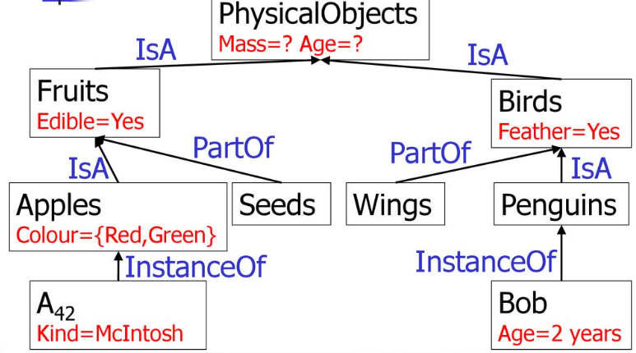
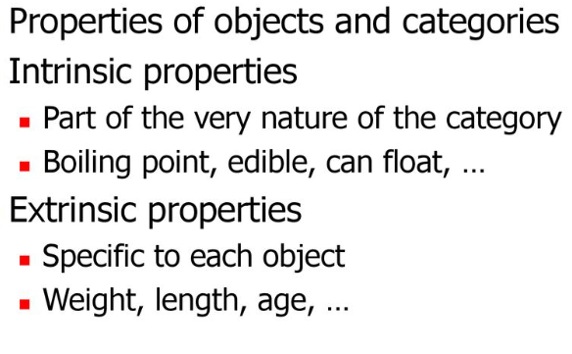
Properties

Slide 63
Application AI and challanges
Enables semantic search, allowing AI systems to understand the context and meaning of search queries.
Facilitates the development of intelligent agents by providing a structured knowledge base.
Supports natural language understanding by defining relationships and concepts.
Enhances machine learning by integrating domain-specific knowledge for better predictions and reasoning.
Challenges:
Complexity: Developing ontologies for large domains can be time-intensive.
Consistency: Ensuring logical coherence across the ontology.
Evolution: Adapting ontologies to changes in domain knowledge.
Tools and Expertise: Requires specialized software and skills.
Notes:
FEATURES:
- Hierarchical Structure: Organizes knowledge in a tree-like structure.
- Semantic Richness: Captures complex relationships and properties.
- Domain Specificity: Tailored to specific fields (e.g., medicine, engineering).
- Support for Reasoning: Enables inference of new knowledge from existing data.
Benefits:
- Knowledge Sharing: Ensures consistent understanding across systems.
- Reusability: Ontologies can be reused across different applications.
- Interoperability: Facilitates integration between systems with shared ontologies.
- Scalability: Adapts to complex and growing datasets.
TOOLS
Protégé: Open-source ontology editor.
- OWL (Web Ontology Language): Standard for creating ontologies.
- RDF (Resource Description Framework): Framework for representing information.
- SPARQL: Query language for ontologies.

Slide 64
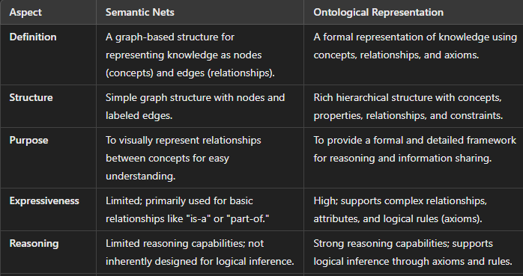
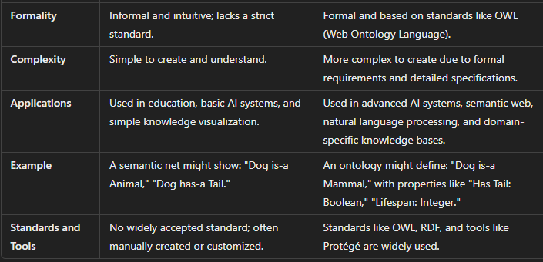
Notes:
Semantic nets and ontological representations are both methods for structuring and representing knowledge, but they differ in purpose, structure, and application. Here's a detailed comparison:
AspectSemantic NetsOntological RepresentationDefinitionA graph-based structure for representing knowledge as nodes (concepts) and edges (relationships).A formal representation of knowledge using concepts, relationships, and axioms.StructureSimple graph structure with nodes and labeled edges.Rich hierarchical structure with concepts, properties, relationships, and constraints.PurposeTo visually represent relationships between concepts for easy understanding.To provide a formal and detailed framework for reasoning and information sharing.ExpressivenessLimited; primarily used for basic relationships like "is-a" or "part-of."High; supports complex relationships, attributes, and logical rules (axioms).ReasoningLimited reasoning capabilities; not inherently designed for logical inference.Strong reasoning capabilities; supports logical inference through axioms and rules.FormalityInformal and intuitive; lacks a strict standard.Formal and based on standards like OWL (Web Ontology Language).ComplexitySimple to create and understand.More complex to create due to formal requirements and detailed specifications.ApplicationsUsed in education, basic AI systems, and simple knowledge visualization.Used in advanced AI systems, semantic web, natural language processing, and domain-specific knowledge bases.ExampleA semantic net might show: "Dog is-a Animal," "Dog has-a Tail."An ontology might define: "Dog is-a Mammal," with properties like "Has Tail: Boolean," "Lifespan: Integer."Standards and ToolsNo widely accepted standard; often manually created or customized.Standards like OWL, RDF, and tools like Protégé are widely used Semantic Nets are intuitive and easier to use for visualizing simple relationships.
Ontological Representations are formal, detailed, and suited for complex knowledge systems requiring reasoning and interoperability.

